Slide 1
Leading

Slide 2
Motivation
Motivation is a human psychological characteristic that contributes to a person’s degree of commitment.
It includes the factors that cause, channel, and sustain human behavior in a particular committed direction.
Motivating is the management process of influencing people’s behavior based on the knowledge of ‘what makes people tick’.

Slide 3
Early Theories of Motivation
Traditional Model – Frederick Taylor
Work is inherently distasteful to most people.
What they do is less important than what they earn for doing it.
Few want or can handle work that requires creativity, self-direction or self control.
Human Relations Model – Elton Mayo
People want to feel useful and important.
People want to belong and to be recognized as individuals.
These needs are more important than money in motivating people to work.

Slide 4
Early Theories of Motivation
Human Resources Model – Douglas McGregor
McGregor identified two different sets of assumptions about employees.
Theory X
People have an inherent dislike of work.
Work is of secondary importance and managers must push employees to work.
Theory Y
Work is as natural as play or rest.
People derive a great deal of satisfaction from work.
People have the capacity to accept and even seek responsibility.

Slide 5
Comparison of Assumptions
Factor Theory X Assumptions Theory Y Assumptions
Employee attitude Employees dislike work and Employees enjoy work and towards work will avoid it if at all possible. will actively seek it. Management view Employees must be directed, Employees are self-motivated of direction coerced, controlled, or threatened and self-directed toward achieving to get them to put forth adequate effort. organizational goals. Employee view Employees wish to avoid responsibility; Employees seek responsibility; of direction they prefer to be directed and told what they wish to use their creativity, to do and how to do it. imagination, and ingenuity in performing their jobs.
Management style Authoritarian style of management Participatory style of management

Slide 6
Contemporary Theories of Motivation
This can be broadly classified as content theories and process theories.
Content Theories
These are based on human needs.
Process Theories
These are based on the assumption that behavior is determined by expected outcomes.

Slide 7
Content Theories: Maslow’s Hierarchy of Needs
Maslow's hierarchy of needs is a theory of motivation and personality developed by the psychologist Abraham H. Maslow (1908-1970).
This explains human behavior in terms of basic requirements for survival and growth.
SA
Esteem
Lowest to highest order
Social
Safety
Physiological

Slide 8
Maslow’s Hierarchy of Needs
Physiological Needs: Air, water, food, shelter & sex
Safety Needs: Job & security
Social Needs: Relations with friends, family & group acceptance
Esteem Needs: Self respect, reputation, prestige & recognition
Self Actualization Needs: The desire to become everything one is capable (potential) of becoming

Slide 9
Alderfer’s ERG Theory
ERG theory is a theory of motivation that says people strive to meet a hierarchy of existence, relatedness and growth.
Growth
SA
Esteem
Relatedness
Social
Safety
Existence
Physiological

Slide 10
McClelland’s Need Theory
Need for Achievement (nAch): This is the need for challenge, for personal accomplishment and success in competitive situations.
Need for Power (nPow): This is the need to dominate, influence and control people.
Need for Affiliation (nAff): This is the need that concerns an individual to establish and maintain warm, close & intimate relationships with other people.

Slide 11
Herzberg’s Two Factor Theory
From research, Herzberg concluded that job dissatisfaction and job satisfaction arose from two separate sets of factors (Hygiene & Motivation).
Dissatisfiers (hygiene factors) included salary, working conditions, and company policy – all of which affected the context in which work was conducted. Positive ratings for these factors did not lead to job satisfaction but merely to the absence of dissatisfaction. (Ex: Extrinsic - Employee’s feelings)
Satisfiers (motivating factors) include achievement, recognition, responsibility, and advancement – all related to the job content and the rewards of work performance. Positive ratings for these factors lead to job satisfaction. (Ex: Intrinsic - Job enrichment)

Slide 12
Motivation-Hygiene Theory
Company policy & administration
Supervision
Interpersonal relations
Working conditions
Salary
Status
Security
Motivation factors increase job satisfaction
Achievement
Achievement recognition
Work itself
Responsibility
Advancement
Growth
Hygiene factors avoid
job dissatisfaction

Slide 13
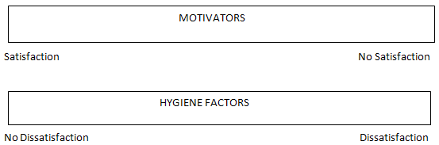
Herzberg’s Two Factor Theory

Slide 14
Process Theories: Adam’s Equity Theory
Equity theory is based on the assumption that a major factor in job motivation is the individual’s evaluation of the equity or fairness of the reward received.
Equity can be defined as a ratio between the individual’s job inputs (such as effort or skill) and job rewards (such as pay or promotion).
According to equity theory, individuals are motivated when they experience satisfaction with what they receive from an effort in proportion to the effort they apply.

Slide 15
Adam’s Equity Theory
People judge the equity of their rewards by comparing them either to the rewards others are receiving for similar input or to some other effort/reward ratio that occurs to them.
Ratio Comparison Perception
O/I a < O/I b Under-rewarded (Equity Tension)
O/I a = O/I b Equity
O/I a > O/I b Over-rewarded (Equity Tension)

Slide 16
Victor Vroom’s Expectancy Theory
Expectancy theory argues that the strength of a tendency to act in a certain way depends on the strength of an expectation that the act will be followed by a given outcome and on the attractiveness of that outcome to the individual.
The theory focuses on three components and relationships:
Components
Valence: Value or importance placed on a particular reward.
Expectancy: Belief that effort leads to performance.
Instrumentality: Belief that performance is related to rewards.

Slide 17
Victor Vroom’s Expectancy Theory
Relationships
Effort-performance relationship: The probability perceived by the individual that exerting a given amount of effort will lead to performance.
Performance-reward relationship: The degree to which the individual believes that performing at a particular level he or she will attain the desired outcome or expectations of his employer.
Rewards-personal goals relationship: The degree to which organizational rewards satisfy individual personal goals or needs and the attractiveness is of those potential rewards for the individual.

Slide 18
Victor Vroom’s Expectancy Theory
Expectancy Model
Effort
Performance
Reward
Effort
Perceived effort -
performance
probability
Perceived
performance -
reward probability
Perceived
value of reward
“If I work hard,
will I get the job
done?”
“What rewards
will I get when
the job is well done?”
“What rewards
do I value?”

Slide 19
Behavior Modification
Behavior modification uses reinforcement theory to change human behavior.
Reinforcement theory, associated with the psychologist B F Skinner and others, shows how the consequences of past behavior affect future actions in a cyclical learning process. This process may be expressed as follows:
Stimulus –> Response –> Consequences –> Future
Response
Types of Reinforcements:
Positive Reinforcement
Negative Reinforcement
Punishment
Extinction

Slide 20
Leadership
Leadership is the art or process of influencing people so that they will strive willingly & enthusiastically towards the achievement of the organizational vision and goal.
It is also defined as the process of directing and influencing the task related activities of group members.

Slide 21
Approaches to Leadership: Trait Approach
Trait theory assumes that leaders are born, not made; that is, they share certain inborn personality traits.
This approach to leadership differentiates leaders from non-leaders by focusing on personal qualities and characteristics.
Certain Traits:
Physical Qualities: Health, Endurance
Personal Attributes: Enthusiasm, Ability to Inspire, Persuasiveness, Forcefulness, Tact
Character Attributes: Integrity, Humanism, Self Discipline, Stability
Intellectual Qualities: Mental Capacity, Ability to Teach, Scientific Approach to Problems

Slide 22
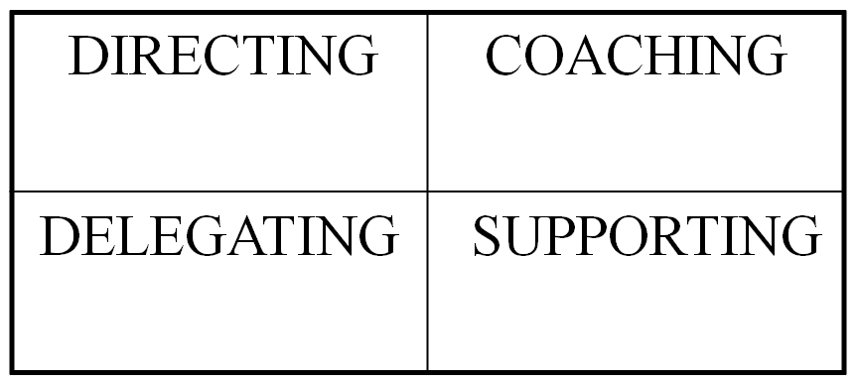
Behavioral Approach
Theories proposing that specific behaviors differentiate leaders from nonleaders.
Leaders could be taught to be effective if required behavioral patterns could be implanted in individuals.
There are two aspects of leadership behavior:
Leadership functions and Leadership styles
HIGH
Task oriented
LOW
Relationship oriented
HIGH

Slide 23
Continuum of Leadership Behavior
A continuum of leadership style extends from complete retention of power by the manager to complete freedom for subordinates.
Autocratic (Telling): Manager makes decisions with little or no involvement of nonmanagers.
Diplomatic (Selling): Manager makes decisions without consultation but tries to persuade nonmanagers to accept them.
Consultative (Consulting): Managers obtains nonmanagers’ ideas and uses them in decision making.
Participative (Joining): Manager involves nonmanagers heavily in the decision making and may even delegate it to them completely.

Slide 24
The Ohio State Studies
Initiating Structure
This refers to the extent to which a leader is likely to define and structure his or her role and those of employees in the search for goal attainment.
The leader characterized as high in initiating structure could be described as someone who assigns group members to particular tasks, expects workers to maintain definite standards of performance and emphasized the meeting of deadlines.
Consideration
This is described as the extent to which a person is likely to have job relationships that are characterized by mutual trust, respect for employees’ ideas and regard for their feelings.
A leader high in consideration could be described as one who helps employees with personal problems, is friendly and approachable and treats all employees as equals.

Slide 25
The University of Michigan Studies
Employee-oriented leaders were associated with higher group productivity and higher job satisfaction.
Production-oriented leaders tended to be associated with low group productivity and lower job satisfaction.
Although the Michigan studies emphasized employee-oriented leadership (or consideration) over production oriented leadership (or initiating structure), the Ohio State studies garnered more research attention and suggested that both consideration and initiating structure are important to effective leadership.

Slide 26
Blake and Mouton’s Managerial Grid
Robert Blake and Jane Mouton proposed a graphic portrayal of leadership styles through a managerial grid (sometimes called leadership grid).
The grid depicted two dimensions of leader behavior, concern for people (accommodating people’s needs and giving them priority) on y-axis and concern for production (keeping tight schedules) on x-axis, with each dimension ranging from low (1) to high (9), thus creating 81 different positions in which the leader’s style may fall.

Slide 27
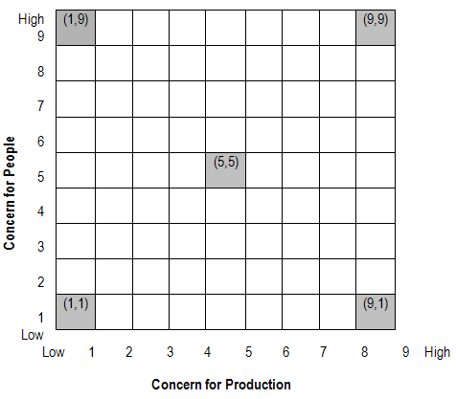
Blake and Mouton’s Managerial Grid

Slide 28
Blake and Mouton’s Managerial Grid
(1,9) - least concern for task and utmost concern for people (laissez faire).
(9,1) - least concern for people and utmost concern for task (authority).
(1,1) - least concern for people and least concern for task.
(5,5) - equal concern for task and people.
(9,9) - highest concern for both people and task.

Slide 29
Contingency Approach
This approach focuses on the following factors:
Task requirements
Peers’ expectations and behavior
Employees’ characteristics, expectations and behavior
Organizational culture and policies

Slide 30
Hersey and Blanchard’s Situational Leadership Model
According to this model, the leader has to match the leadership style according to the readiness of subordinates which moves in stage and has a cycle. Therefore, this theory is also known as the life-cycle theory of leadership.
Readiness is the extent to which followers have the ability and willingness to accomplish a specific task.
Ability is the knowledge, experience, and skill that an individual possesses to do the job and is called job readiness.
Willingness is the motivation and commitment required to accomplish a given task.

Slide 31
Hersey and Blanchard’s Situational Leadership Model
The style of leadership depends on the level of readiness of the followers.
The readiness (R) is divided into a continuum of four levels which are:
R1 - low follower readiness: refers to low ability and low willingness of followers i.e. those who are unable and insecure.
R2 - low to moderate follower readiness: refers to low ability and high willingness of followers i.e. those who are unable but confident.
R3 - moderate to high follower readiness: refers to high ability and low willingness of followers i.e. those who are able but insecure.
R4 - high follower readiness: refers to high ability and high willingness of followers i.e. those who are both able and confident.

Slide 32
Hersey and Blanchard’s Situational Leadership Model
For each of the four levels of readiness, the leadership style used may be a combination of task and relationship behavior.
Task behavior: Extent to which the leader spells out the duties and responsibilities of a follower which includes providing them direction, setting goals, and defining roles for them. Usually a one-way communication exists which is meant to provide the direction to the followers.
Relationship behavior: Extent to which the leader listens to the followers, and provides encouragement to them. Here, a two-way communication exists between the leader and the follower.

Slide 33
Hersey and Blanchard’s Situational Leadership Model
By combining the task and the relationship behavior, we arrive at the following four different styles of leadership which correspond with the different levels of readiness.
S1 - Telling: This style is most appropriate for low follower readiness (R1). It emphasizes high levels of both task and relationship behavior.
S2 - Selling: This style is most appropriate for low to moderate follower readiness (R2). It emphasizes high levels of task behavior and limited relationship behavior.
S3 - Participating: This style is most appropriate for moderate to high follower readiness (R3). It emphasizes high levels of relationship behavior but limited task behavior.
S4 - Delegating: This style is most appropriate for high follower readiness (R4). It emphasizes low levels of both task and relationship behavior.

Slide 34
Leadership Style and the Work Situation: The Fiedler Model
This theory of leadership effectiveness was based on the studies of a wide range of group effectiveness, and concentrated on the relationship between leadership and organizational performance.
According to this theory, if an organization attempts to achieve group effectiveness through leadership, then there is a need to assess the leader according to an underlying trait, assess the situation faced by the leader, and construct a proper match between the two.
In order to assess the attitudes of the leader, Fiedler developed the ‘least preferred co-worker’ (LPC) scale in which the leaders are asked about the person with whom they least like to work.

Slide 35
Leadership Style and the Work Situation: The Fiedler Model
The scale is a questionnaire consisting of 16 items used to reflect a leader’s underlying disposition toward others.
The items in the LPC scale are pleasant / unpleasant, friendly / unfriendly, rejecting / accepting, unenthusiastic / enthusiastic, tense / relaxed, cold / warm, helpful / frustrating, cooperative / uncooperative, supportive / hostile, quarrelsome / harmonious, efficient / inefficient, gloomy / cheerful, distant / close, boring / interesting, self-assured / hesitant, open / guarded.
Each item in the scale is given a single ranking of between one and eight points, with eight points indicating the most favorable rating.

Slide 36
Leadership Style and the Work Situation: The Fiedler Model
Situational factor
According to Fiedler, a leader’s behavior is dependent upon the favorability of the leadership situation. Three factors work together to determine how favorable a situation is to a leader.
Leader-member relations: The degree to which the leader is trusted and liked by the group members, and the willingness of the group members to follow the leader’s guidance (good / poor).
Task structure: The degree, to which the group’s task has been described as structured or unstructured, has been clearly defined and the extent to which it can be carried out by detailed instructions (structured / unstructured).
Position power: The power of the leader by virtue of the organizational position and the degree to which the leader can exercise authority on group members in order to comply with and accept his direction and leadership (strong / weak).

Slide 37
Leadership Style and the Work Situation: The Fiedler Model
With the help of these three variables, eight combinations of group-task situations were constructed by Fiedler. These combinations were used to identify the style of the leader.
The leader’s effectiveness is determined by the interaction of the leader’s style of behavior and the favorableness of the situational characteristics. The most favorable situation is when leader-member relations are good, the task is highly structured, and the leader has a strong position power.
Fiedler also suggested that leaders may act differently in different situations. Relationship-oriented leaders generally display task-oriented behaviors under highly favorable situations and display relationship-oriented behaviors under unfavorable or intermediate favorable situations. Similarly, task-oriented leaders frequently display task-oriented in unfavorable or intermediate favorable situations but display relationship-oriented behaviors in favorable situations.

Slide 38
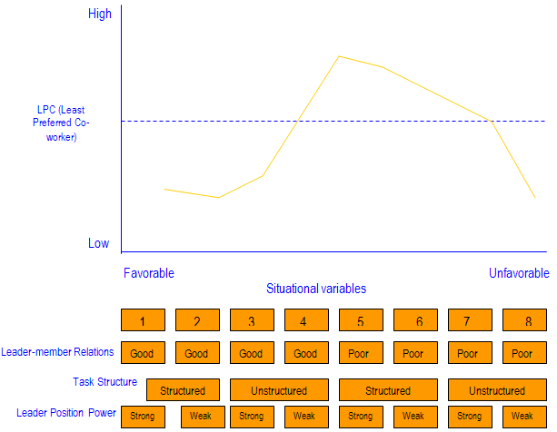
Leadership Style and the Work Situation: The Fiedler Model
Research on the contingency model has shown that task-oriented leaders are more effective in highly favorable (1, 2, 3) and highly unfavorable situation (7, 8) whereas relationship-oriented leaders are more effective in situations of intermediate favorableness (4, 5, 6).

Slide 39
The Path Goal Model
Path Goal theory was developed by Robert House and has its roots in the expectancy theory of motivation.
The theory is based on the premise that an employee’s perception of expectancies between his effort and performance is greatly affected by a leader’s behavior.
The leaders help group members in attaining rewards by clarifying the paths to goals and removing obstacles to performance.
As per this model, leadership is not viewed as a position of power, rather, leaders act as coaches and facilitators to their subordinates.

Slide 40
The Path Goal Model
According to House’s path-goal theory, a leader’s effectiveness depends on several employee and environmental contingent factors and certain leadership styles.
Directive: Here the leader provides guidelines, lets subordinates know what is expected of them, sets performance standards for them, and controls behavior when performance standards are not met.
Supportive: The leader is friendly towards subordinates and displays personal concern for their needs, welfare, and well-being.
Participative: The leader believes in group decision-making and shares information with subordinates. He consults his subordinates on important decisions related to work, task goals, and paths to resolve goals.
Achievement-oriented: The leader sets challenging goals and encourages employees to reach their peak performance. The leader believes that employees are responsible enough to accomplish challenging goals.

Slide 41
The Path Goal Model
According to the theory, these leadership styles are not mutually exclusive and leaders are capable of selecting more than one kind of a style suited for a particular situation.
It further states that the relationship between a leader’s style and effectiveness is dependent on the following variables:
Environmental Contingency Factors
Task Structure
Formal Authority System
Work Group
Personal Characteristics
Locus of Control
Experience
Perceived Ability
Outcomes
Performance
Satisfaction

Slide 42
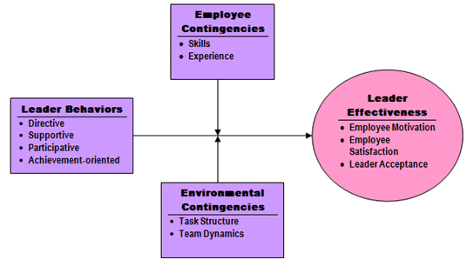
The Path Goal Model
Directive leadership leads to greater satisfaction when tasks are ambiguous or stressful.
Supportive leadership results in high employee performance and satisfaction when employee are performing structured tasks.
Participative leadership leads to greater satisfaction in employees with an internal focus of control.
Achievement oriented leadership results in high employee performance when tasks are ambiguously structured.

Slide 43
Transactional Leadership
Transactional leadership involves motivating and directing followers primarily through appealing to their own self-interest.
The main goal of the follower is to obey the instructions of the leader. The style can also be mentioned as a ‘telling style’.
The leader believes in motivating through a system of rewards and punishment.
These exchanges involve four dimensions:
Contingent Reward: Contracts exchange of rewards for effort, promises rewards for good performance and recognizes accomplishments.
Management by Exception (active): Watches and searches for deviations from rules and standards, takes correct action.
Management by Exception (passive): Intervenes only if standards are not met.
Laissez Faire: Abdicates responsibilities and avoids making decisions.

Slide 44
Transformational Leadership
Transformational leadership may be found at all levels of the organization: teams, departments, divisions, and organization as a whole.
Such leaders are visionary, inspiring, daring, risk-takers, and thoughtful thinkers. They have a charismatic appeal.
For bringing major changes, transformational leaders must exhibit the following four factors:
Idealized influence: Provide vision as sense of mission, instills pride, gains respect and trust.
Inspirational motivation: Communicates high expectations, uses symbols to focus efforts, and expresses important purposes in simple ways.
Intellectual Stimulation: Promotes intelligence, rationality, and careful problem solving.
Individualized Consideration: Gives personal attention, treats each employee individually, coaches and advises.

Slide 45
Teams and Team Work
A team is a group of individuals, all working together for a common purpose.
They should all work together and strive towards the achievement of a common goal.
Individuals who are not compatible with each other can never form a team.
The team members must complement each other and work in unison.
Personal interests must take a back seat and all of them must deliver their level best to achieve the team objective.

Slide 46
Types of Teams
Permanent Team
These teams perform on a permanent basis and are not dissolved once the task is accomplished.
Work or no work, the human resources team, operation team, administration team always function effectively throughout the year and hence are permanent teams.
Temporary Team
Such teams are usually formed for a shorter duration either to assist the permanent team or work when the members of the permanent team are busy in some other project.
Task Force/Project Team
Such teams are formed for a special purpose of working on any specific project or finding a solution to a very critical problem.
The government generally appoints special teams to investigate critical issues like bomb blasts, terrorist attacks and so on.

Slide 47
Types of Teams
Committee
Committees are generally formed to work on a particular assignment either permanently or on a temporary basis.
Individuals with common interests, more or less from the same background, come together on a common platform to form a committee and work on any matter.
Organization/Work Force
Such groups are formed in organizations where team members work together under the expert guidance of leader.
A leader or a supervisor is generally appointed among the members itself and he along with his team works hard to achieve a common goal.
Self Managed Team
Self Managed Teams consist of individuals who work together again for a common purpose but without the supervision of any leader.
Here as the name suggests every individual is accountable for his individual performance.

Slide 48
Types of Teams
Cross Functional Team
Individuals from different areas come and work together for a common objective to form a cross functional team.
In such teams, people from different areas, interests and likings join hands to come out with a unique idea to successfully complete a task.
Virtual Team
Virtual teams consist of individuals who are separated by distances and connected through a network. Here individuals communicate with each other online through internet.
Such teams are helpful when employees need to connect with each other and are located at different places.

Slide 49
Stages of Team Development
Forming: The first stage in group development, characterized by much uncertainty about group’s purpose, structure & leadership. Members ‘test the waters’ to determine what types of behaviors are acceptable.
Storming: The second stage in group development, characterized by intragroup conflict. Members accept the existence of the group, but there is resistance to the constraints that the group imposes on individuality. Further, there is conflict over who will control the group.
Norming: The third stage in group development, characterized by close relationships and cohesiveness. There is a strong sense of group identity & camaraderie.
Performing: The fourth stage in group development, during which the group is fully functional. Group energy has moved from getting to know & understand each other to performing the task at hand.
Adjourning: The final stage in group development for temporary groups, characterized by concern with wrapping up activities rather than task performance.

Slide 50
Team Norms and Cohesiveness
Team Norms
Tells what is expected of you under certain situations.
Acceptable standards of behavior within a group that are shared by the group’s members.
Team Cohesiveness
It is the degree to which group members are attracted to each other and are motivated to stay in the group.
The solidarity or cohesiveness of a team is an important indicator of how much influence the group has over its individual members.
Cohesiveness
High
Low
High Productivity
Moderate Productivity
High
Performance Norms
Low Productivity
Moderate to Low Productivity
Low

Slide 51
Communication
The process of passing any information from one person to the other person with the aid of some medium is termed as communication.
The first party who sends the information is called the sender and the second party who receives the information, decodes the information and accordingly responds is called the receiver or the recipient.
Types of communication:
Verbal Communication: words, speeches, presentations
Non Verbal Communication: Facial expressions, gestures, hand movements
Visual Communication: signboards, displays, hoardings, banners, maps

Slide 52
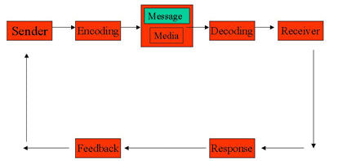
Interpersonal Communication Process

